Slide 1
Section Dividers
These types of slides can be used to break up larger topics in the presentation. The following are the next slides coming up.
Using Placeholders
Adding Alt text
Text Accessibility

Slide 2

Using Placeholders
Use the placeholder boxes within the template to insert content. Each layout is formatted with accessibility in mind and should be used accordingly. Placing content using the toolbar could interfere with the reading order for users with screen readers.

Slide 3
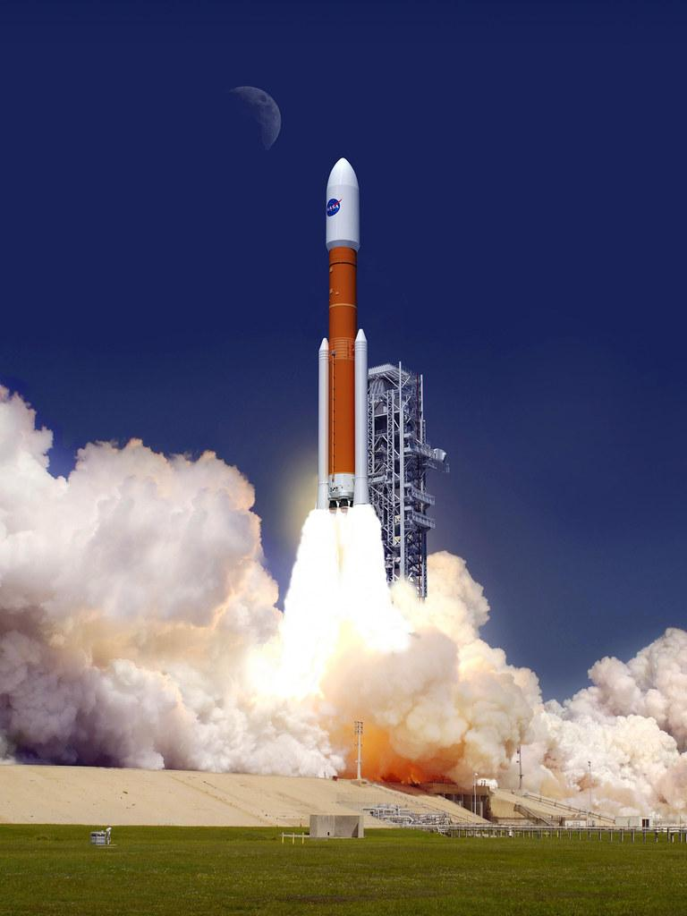
Adding Alt Text
Make sure to add alt text to images that convey information. Screen readers read alt text to better help the user understand it’s content. The picture of the rocket to the right contains alt text.
If the image is purely decorative like a background, mark it as decorative in the “alt text” panel.
This Photo by Unknown Author is licensed under CC BY-NC

Slide 4
Text Accessibility
All the slides are formatted with 28pt font. If you need to add more text you can shrink the text to 24pts but no smaller. Keeping text large helps with accessibility.
If you include charts or graphs it may be hard to keep to 24pts.
If you include a chart or graph insert it using the content box like any other slide.
Once you’re finished making your chart insert alt text into it as you would an image.
Pick the points in the graph you are trying to express and type that into the alt text description box.
The following slide has an example chart.

Slide 5
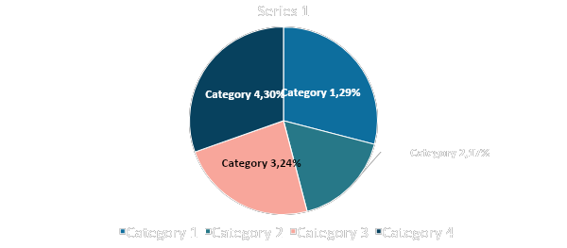
Chart example

Slide 6
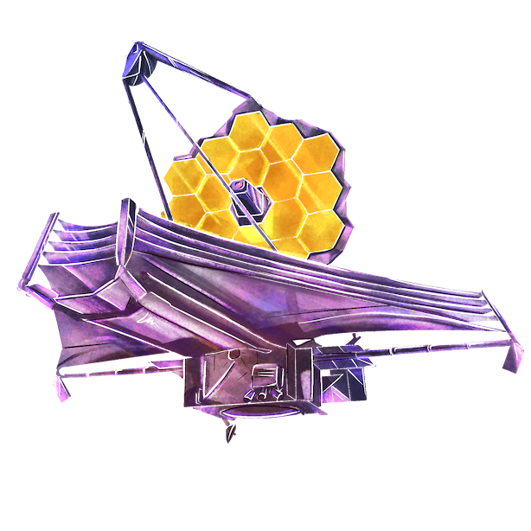
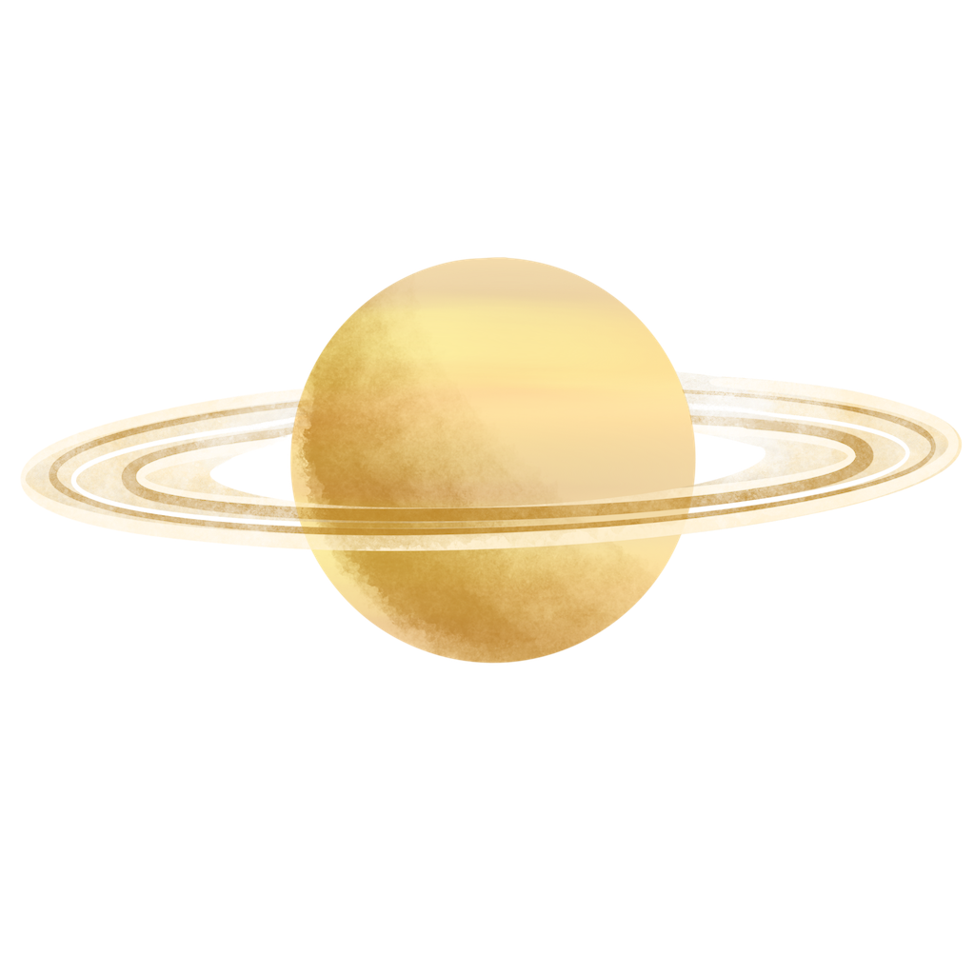



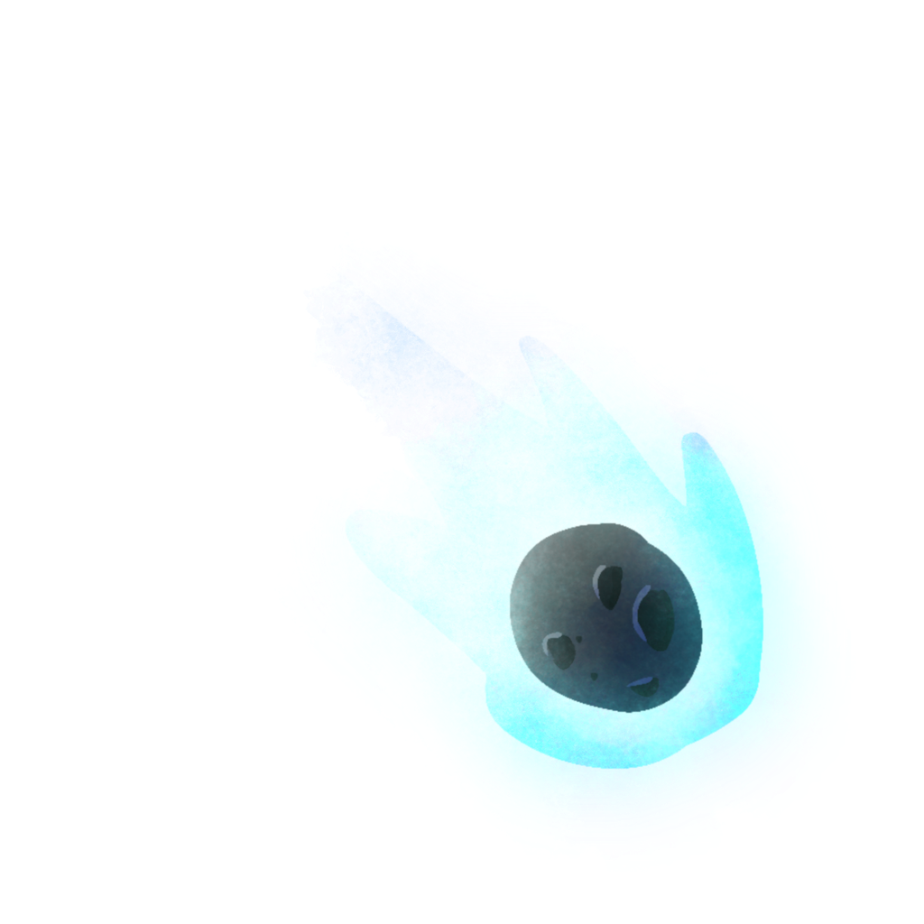


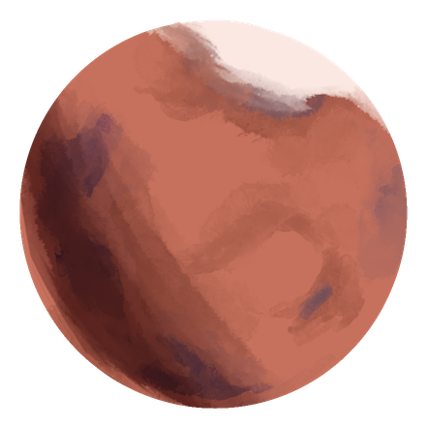




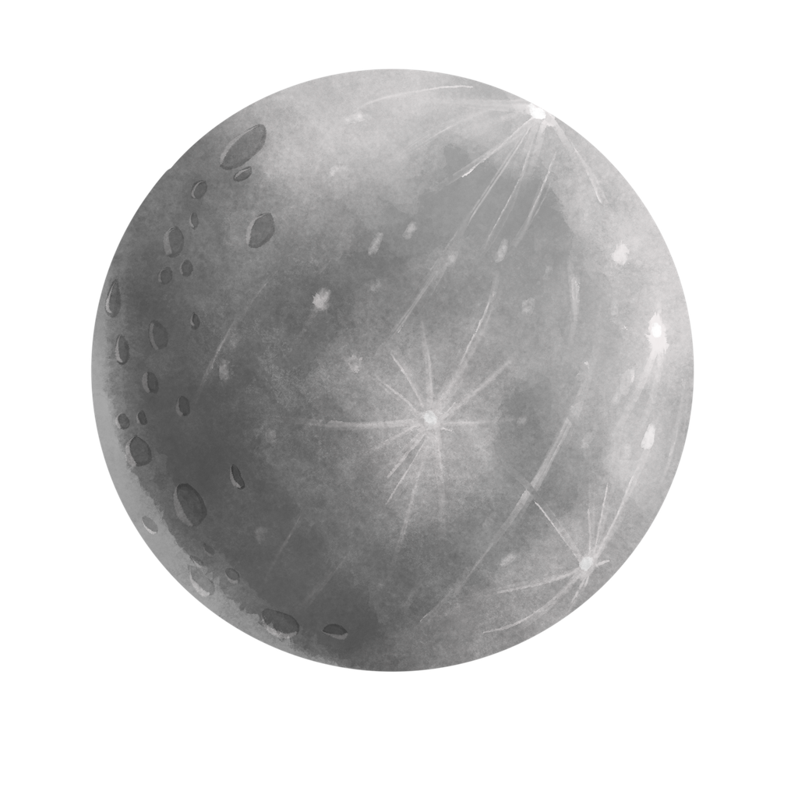

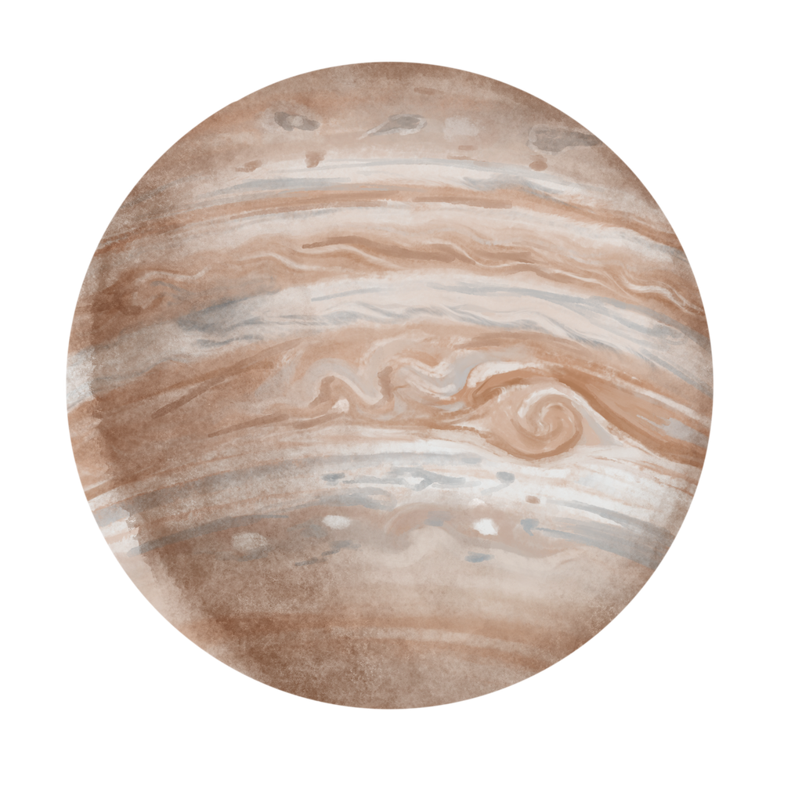

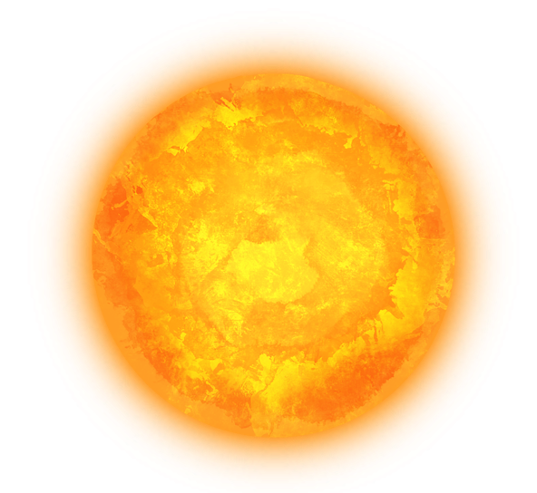
Illustrations for your use
You can copy and paste these illustrations as you see fit in your presentation. They come with alt text already typed in.

Slide 7
We would like your Feedback!
Please type the URL into your browser or click the link in the chat box to access a short feedback form.
https://go.edc.org/NASALibrary
Para realizar en español:
https://go.edc.org/NASALibraryEspanol
Notes:
Please paste the links into the chat box:
https://go.edc.org/NASALibrary
https://go.edc.org/NASALibraryEspanol

Slide 8



James Webb Space Telescope
Notes:
RECORD!!!
Turn off camera
Cole introduce others

Slide 9
Welcome!
Introductions
Housekeeping
A little about JWST
Activities!

Slide 10
Who am I?
Old Dominion University, Norfolk, Virginia
Cyber Operations (class of ‘24)
Lifelong science and space lover

Slide 11
Libraries
Rachel Culver Georgetown Public Library
Stephanie Crocco Hempstead Public Library
Notes:
Stephanie Vierow-Fields
Dr. Poursardar

Slide 12
Housekeeping
Photo release - forms collected at end of presentation
Take your own photos!
Use hashtag #STEMinLib
Notes:
We’ll be taking photos throughout the presentation and activities
Some may be sent to NASA for publicity purposes.
In order for childrens’ faces to appear in these photos, please sign a release form.
We will collect forms at end

Slide 13
James Webb Space Telescope: The 5 Ws
Notes:
Who what where when why

Slide 14
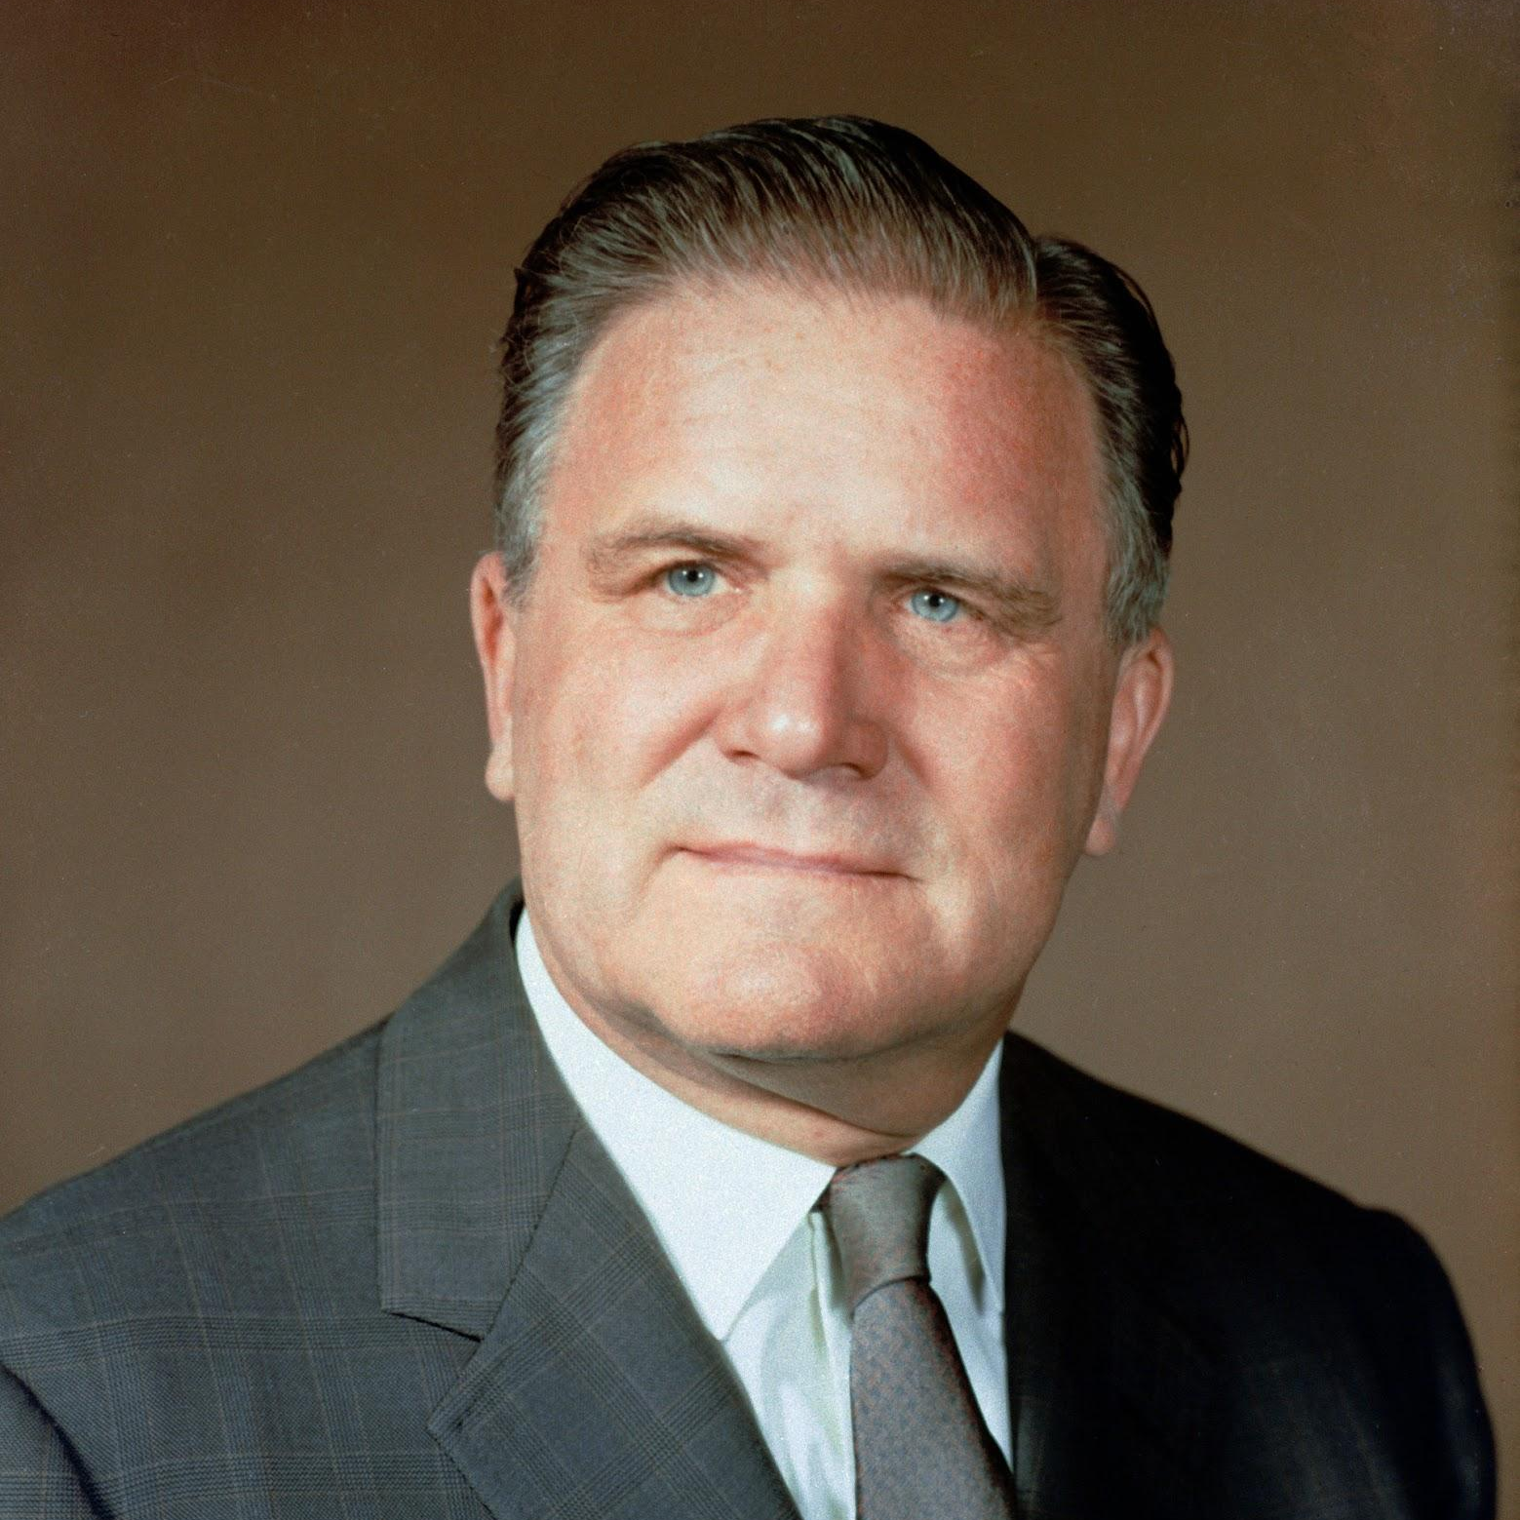



Who?
James E. Webb (photo in public domain)
Oversaw and developed NASA during Apollo program of the 1960s
Notes:
2nd NASA Administrator
NASA and partners:
European Space Agency (ESA)
Canadian Space Agency (CSA)

Slide 15
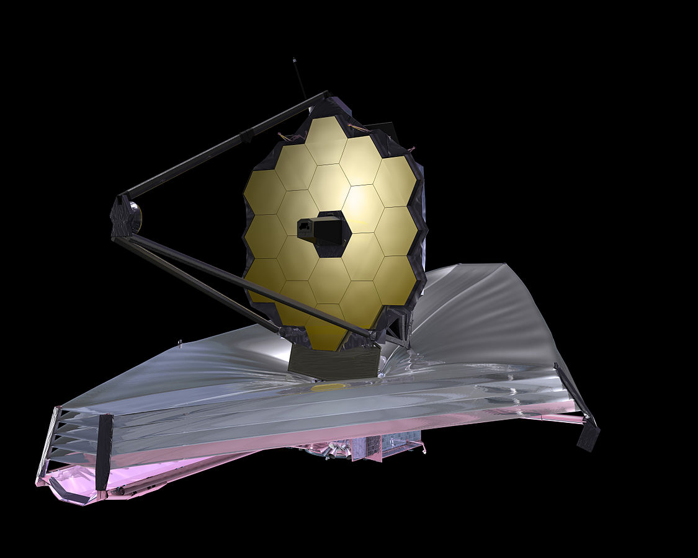
What?
18 large hexagonal mirrors
Infrared sensors (more later)
Intense sun shielding
5 very thin layers
Each layer as large as a tennis court!
This Photo by NASA is in the public domain
Notes:
What is a space telescope? Exactly what it sounds like
Are there any other space telescopes? Hubble, Spitzer

Slide 16
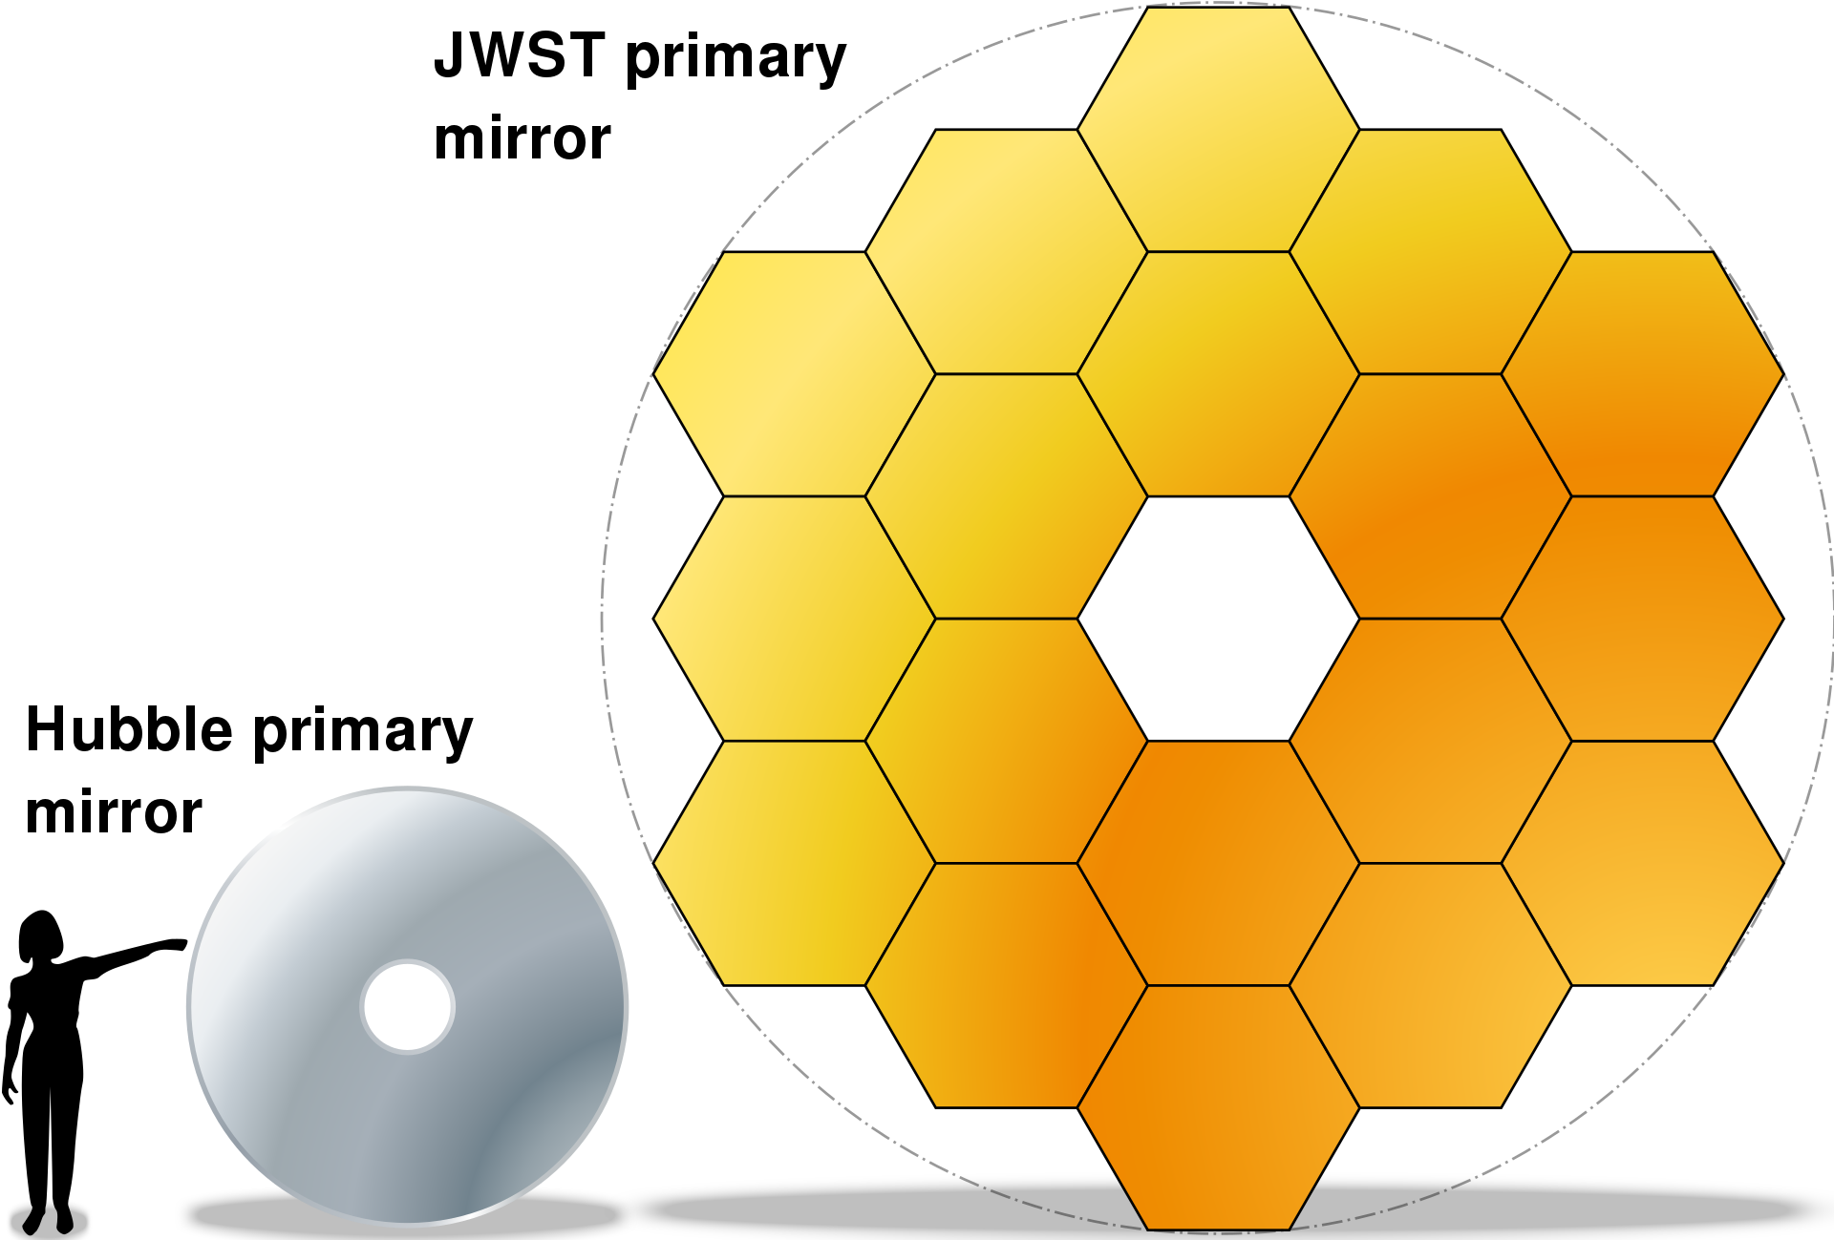
What?: Mirror Comparison
This Photo by Bobarino is licensed under CC BY-SA 3.0
Notes:
Hubble mirror diameter - 2.4 meters
JWST mirror diameter - 6.5 meters

Slide 17
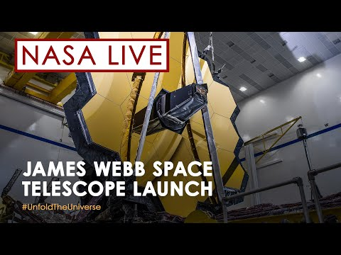
Where?
Notes:
“Where” has a number of answers
Where did it launch? Launched from French Guiana (show on map) in South America on Christmas Day 2021
Where is it now?

Slide 18
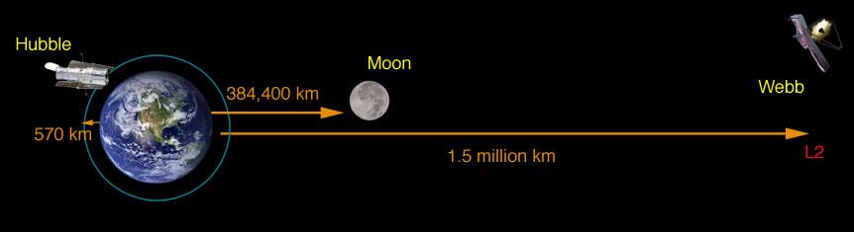
Where?
This Photo by NASA is in the public domain
Notes:
It would take about six hours to drive to Hubble. 570 km ~= 350 miles
The moon orbits at 384k km. You would have to drive all the way around the equator 10 times to get to the moon!
JWST Orbits Sun-Earth Lagrange Point 2
Orbits 1.5 million kilometers from earth
4x as far as the moon!
You’d have to drive around the earth 40 times to get to L2!

Slide 19
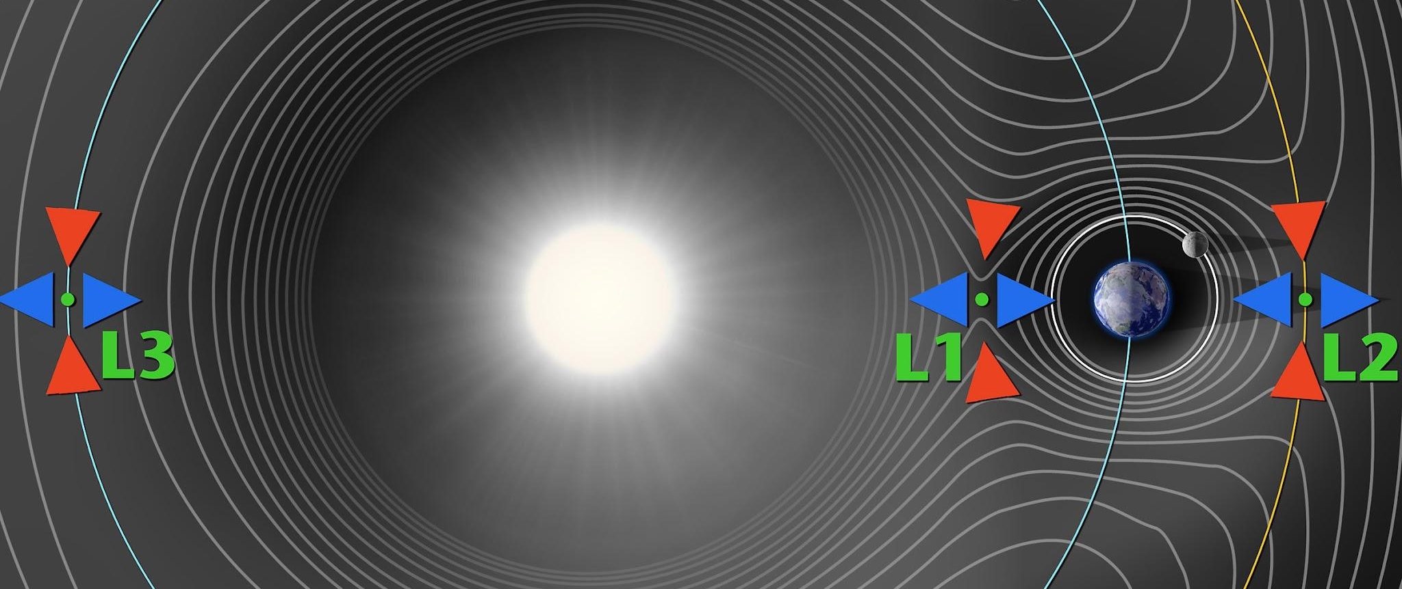
About L2
Any two bodies that orbit each other have 5 “Lagrange points”
Points where gravity “cancels out”
Easy for JWST to stay put there
This Photo by NASA is in the public domain. It has been cropped to show only the portions relative to this presentation
Notes:
Why L2?
Telescope needs to be very cold - remember sun shielding? L2 is very cold
Telescope needs it to be very dark - at L2, sun is always on other side of earth.
With shield facing toward the sun, the telescope is always in shadow - very dark

Slide 20
When?
Year | Events
1996 | Next Generation Space Telescope project started (8 m)
2002 | Named James Webb Space Telescope, Chg to 6 m
2003 | TRW contract awarded to build
2004 | NEXUS cancelled
2007 | ESA/NASA MOU
2010 | MCDR passed
2011 | Proposed cancel
2016 | Final assembly completed
2021 | Launch
Notes:
Started all the way back in 1996 - who was even alive back then?
Some name changes
Launched last year in 2021

Slide 21
Why?
Why a new telescope?
Why is it at L2?
Why do it at all?
Notes:
Why a new telescope?
Hubble won’t last forever
Hubble can’t see the same things JWST can
Why is it at L2? Who remembers why?
Very far from earth - cold
Needs coldness for instruments to work properly
No light pollution from sun, Earth, even moon!
Why do it at all?
To learn more about early universe
To study galaxy formation and evolution
To understand star and planet formation
To seek origins of life

Slide 22
Why?
A picture is worth a thousand words.

Slide 23
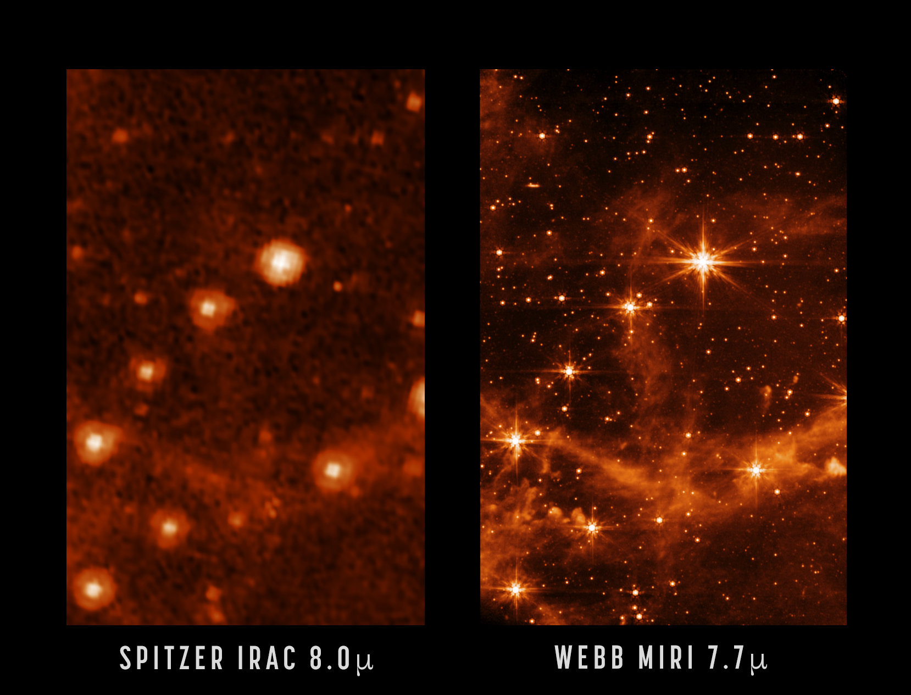
Notes:
First full-color images will be released on July 12, 2022

Slide 24
Questions?

Slide 25
Activity time!

Slide 26
Questions?
Notes:
Wrap up
Thanks for coming!
Pick up a take home kit!
Photo releases
Hashtag #STEMinLib
Thanks to libraries!

Slide 27
More information!
NASA https://www.jwst.nasa.gov/
YouTube https://www.youtube.com/c/NASA
Notes:
Wrap up
Thanks for coming!
Pick up a take home kit!
Photo releases
Hashtag #STEMinLib
Thanks to libraries!

Slide 28
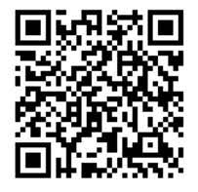
We would like your Feedback!
Please type the URL into your browser or click the link in the chat box to access a short feedback form.
https://go.edc.org/NASALibrary
Para realizar en español:
https://go.edc.org/NASALibraryEspanol
Notes:
Please paste the links into the chat box:
https://go.edc.org/NASALibrary
https://go.edc.org/NASALibraryEspanol

Slide 29
Activity time: Life Cycle of a Massive Star
What does “life cycle” mean?
What are some life cycles you know of?
How do stars form?
Do stars die?
Notes:
Expand - illustrations

Slide 30
Another activity!
[Python demonstration of bookmark activity]

